Slide 1
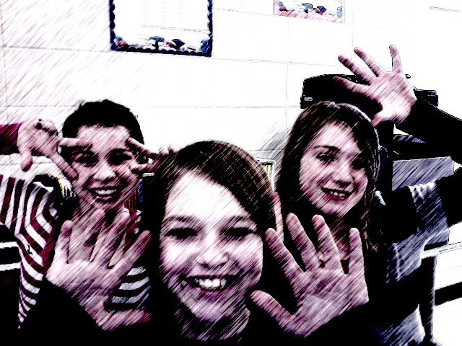
PLANET… ?RANDOM?
BY: HARLEY , BECKY , TYRA

Slide 2
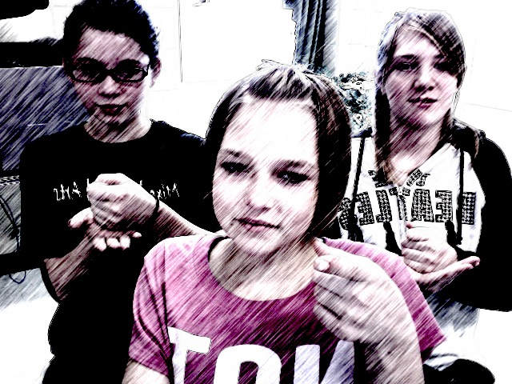
LAWS…
UNLAWFUL TO PLAY CANDY LAND ON SUNDAY.
UNLAWFUL TO WEAR A FAKE MUSTACH IN McDonalds.
NO GIVING SQUIRRELS SODA.
NO SETTING MOUSE TRAPS WITH OUT A HUNTING LICENSE.
NO HUNTING CAMELS.
NO EATING FIRE HYDRANTS.
NO FEEDING PIGONS SMOOTHIES ON EASTER.
TO BE CONTENUED…

Slide 3
SOO MANY LAWS…
NO WEARING SUNGLASSES ON MARCH 22ND
DO NOT PAY FOR ORANGE JUICE WITH MORE THAN TWO PENNIES.
DON’T BITE THE ELDERLY.
MUST BE AT LEAST 8 TO DRIVE.
DON’T DRIVE A DIRTY CAR.
DON’T CHEW GUM ON WEDNESDAY.
MUST BE A LICENSED ELECTRICIAN TO CHANGE A LIGHT BULB.
AGAIN CONTINUED…

Slide 4
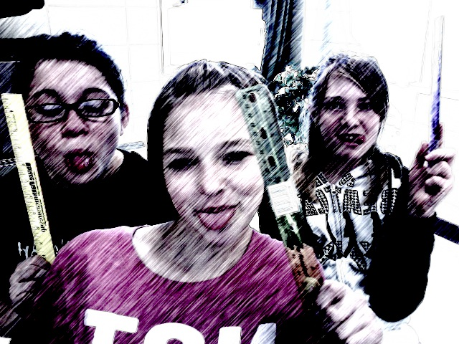
EVEN MORE LAWS…
NO LESS THAN 20 TOPPINGS ON YOUR ICE CREAM.
FIRST MEAL OF THE DAY MUST BE A SALAD.
FINALLY DONE WITH LAWS!!
NOW RULE TIME
ALWAYS FOLLOW THE LAW.
NEVER SAY GUTS!!!!!!!!!!!!
NEVER WACH GOLF!!!

Slide 5
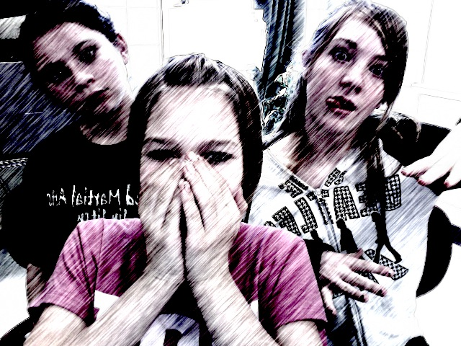
PUNISHMENTS NOW!!!
HANDCUFFED TO A TABLE AND FORCED TO DRINK GALLONS OF WATER.
FORCED TO DRINK RAW CHICKEN SOAKED IN JALAPINEO JUICE.
HAVE TO WEAR HAIR IN A AFRO FOR A WEEK.
NO HANDS FOR A MONTH.
HAVE TO LIVE IN A NURSING HOME FOR A YEAR.
CAN’T EAT CANDY FOR TWO YEARS.
CAN’T DRINK BEEF JERKEY.

Slide 6
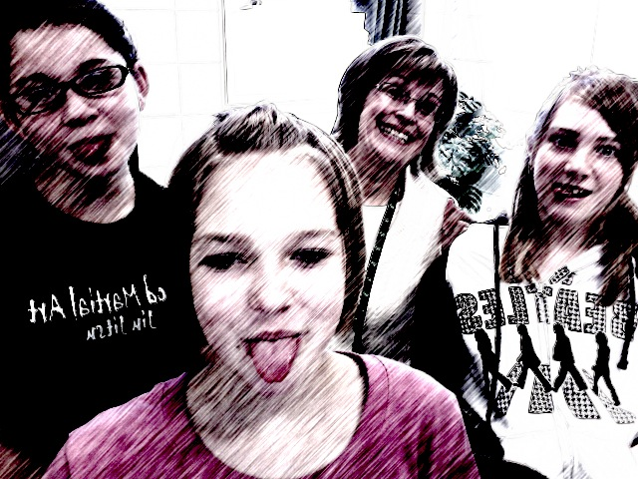
EDUCATION ☹ / ☺
WE LEARN BY TOUCHING AND MOVING
GRAMMER BY LISTINING TO LECTURES AND WHAT OTHER PEOPLE HAVE TO SAY, THEN RESPONDIING.
MUST BE PART OF A BAND, PLAY, OR ACT SCHOOL MUSICAL.
SCHOOL STARTS AT 12:00- 7:00.

Slide 7
WE ARE STILL LEARNING
FREE LUNCH.
NO FATTY FOODS. HEALTHY FOOD ONLY.
EAT WITH CHOP-STICKS ONLY.
MUST DRINK 1 BOTTLE OF WATER BEFORE EACH MEAL

Slide 8
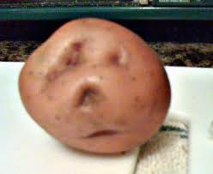
dicTATERship
1st there is an election of the people
2nd create a speech
3rd the people vote
4th must recite all the rules correctly.
5th must lick their elbow
6th must sing all Lady Gaga songs in Espanola

Slide 9
RAISING FAMILIES ☺
Children must feel safe with parents.
To own your children you must have medical care
Teach to have a good attitude with new people.
Christianity must be taught and applied.
You must blow your nose with your favorite shirt using your pinky toe.

Slide 10
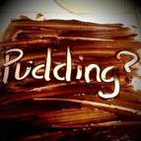
ENJOYMENT☺
Lick your own elbow.
Having pudding or dog food fights. ☺
Slap people silly.
Eat corndogs with syrup .
Listen to Justin Bieber and pretend like your dying (which you will temporarily pass out for 3 days.)
Make toilet paper mummies.

Slide 11
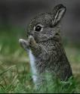
YOU DUMB BUNNY IM NOT YOUR DADDY
Are you my daddy?? ☺

Slide 12
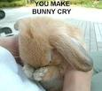
YOU WERE MEAN TO BUNNY

Slide 13
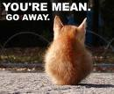
YOU SHOULD FEEL ASHAMED!! ☹
YOU MEAN PEOPLE

Slide 14
SOOOOOO…
HHUUMMNN…
WAIT WHERE DID BUNNY GO?
Oh there you are bunny!!!!

Slide 15
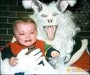
now…BUNNY MAKES YOU CRY!!!!!!!!

Slide 16
MERRY CHRISTMAS!! HA HA HA

