Slide 1
Planet X
By: Tulsi Nursariwala, Andrew Chesney, Gage Fair

Slide 2
Laws
You start having a permit at 16 and have your driver’s license at 18
If you are caught speeding, then there will be a fine for being over the speed limit
Don’t pollute or you will be get a fine

Slide 3
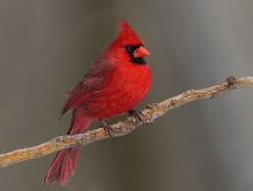
National Items
Animal- Tiger
Flowers- Lily
Tree- Red Oak
Fruit- Watermelon
Bird- Cardinal
Color- Silver

Slide 4
Punishments
If you break a law you are punished for life
Your punishment is being put to sleep and buried

Slide 5
Education
You start school at 4 years of age and end at 17
Schools have security cameras and are very safe
You have to go to college for at least 4 years
You cannot drop out of junior-high, high-school, or college
All students need to try and get all A’s *If they don’t then they will have to be put in summer school or after-school tutoring

Slide 6
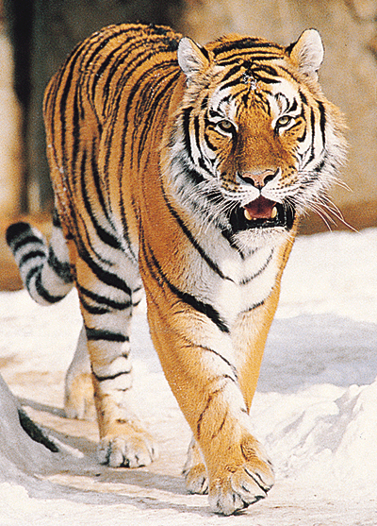
Finding & Choosing Leaders
The government chooses about three people to run for president
Then the people of Planet X will vote for the person out of the people they want as their president
If the people do not like the president that is chosen, the president is not doing any thing for Planet X, then the people have the right to impeach the president

Slide 7
Families
It is encouraged that one parent stays with the child for the first two years of life
Children play outside for an hour so they get energy
Children must eat healthy food
Junk food was never made
All children need

Slide 8
Entertainment
Sports like Tug-of-War, Paintball, Football, Baseball, Basketball, Volleyball, Soccer, Track, Ect.
All children have to sign up for a sport by the time they turn 5 so they can stay active and be healthy
There can only be 30 minutes of television in one day

Slide 9
Kids can have privileges but have to be responsible!

Slide 10
Picture Sources
1.
2.
3.
4.
5.
6. www.animal.howstuffworks.com
7. www.more4kids.info
8. www.eslpod.com

